Slide 1
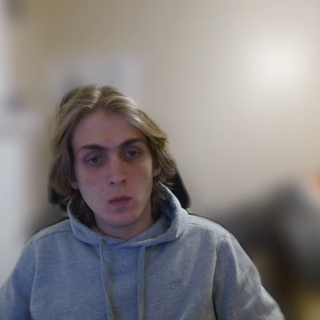
Bearcat Game
Hayden Dennis
Notes:
Hi my name is Hayden Dennis
Presenting project plan
game

Slide 2
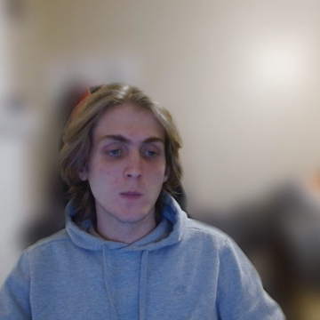
Team Name: 10x devs
Member(s):
Hayden Dennis
Industry Advisor: Austin Coontz
Notes:
Started late so I am the sole contributor

Slide 3
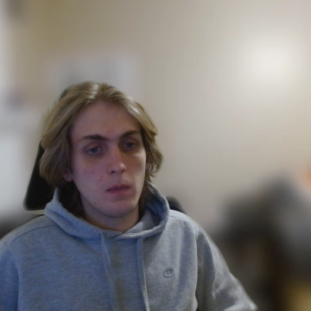
Abstract
Bintrong game is a designed to be a free accessible game for students to study questions using competition. A key goal is make the solution freeware so anyone can host it for free. The plan is for the game application to provide options for generating card packs via LLM.
Notes:
Similarities with fall guys
Brainrot games
Paid features

Slide 4
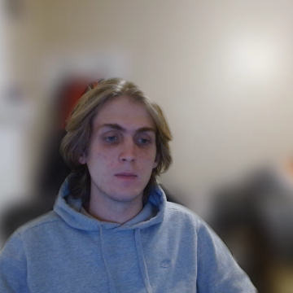
User stories
As a student, I want to be able to review and study in the form of a game to effectively cover materials in a small group.
As a student, I want to be able to automatically generate flashcards via LLM in order to rapidly review material.
As a teacher, I want a game to review materials to engage with students during classroom review sessions.

Slide 5
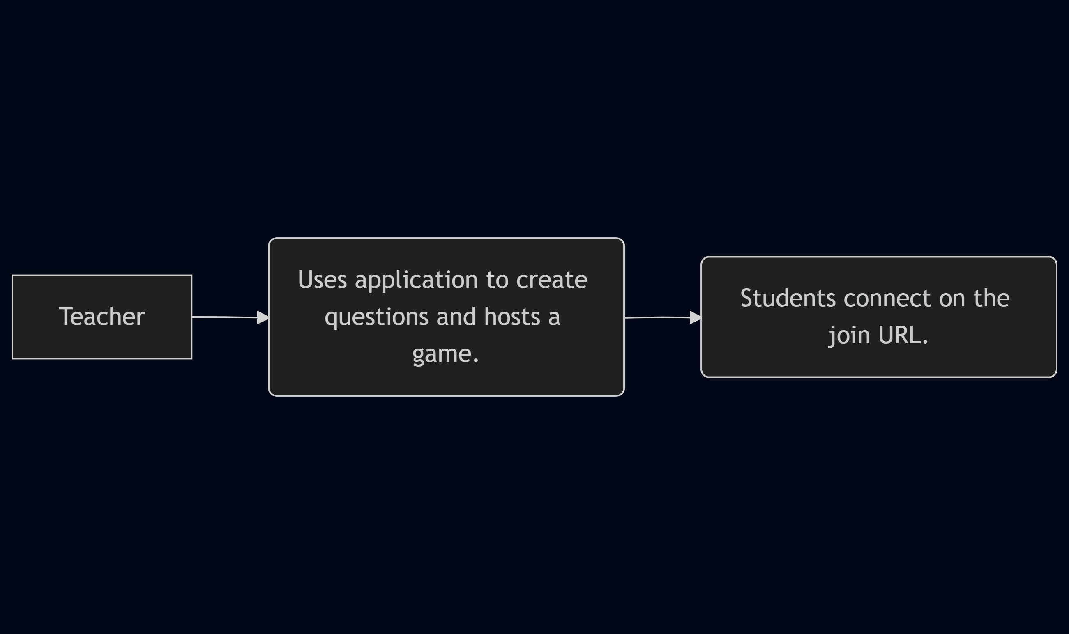
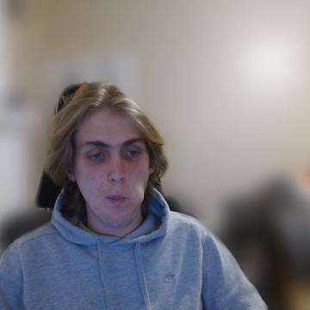
D0
Notes:
Hardbox is the user and soft boxes are actions. This shows the perspective of just the teacher.

Slide 6
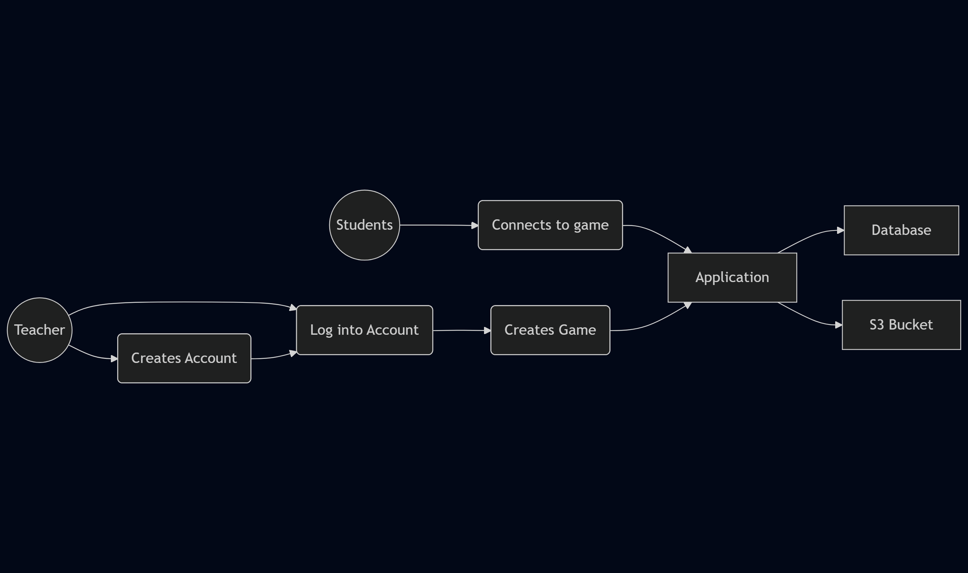
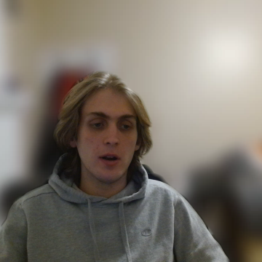
D1
Notes:
Circles are clients, squares are services, soft rectangles are actions

Slide 7
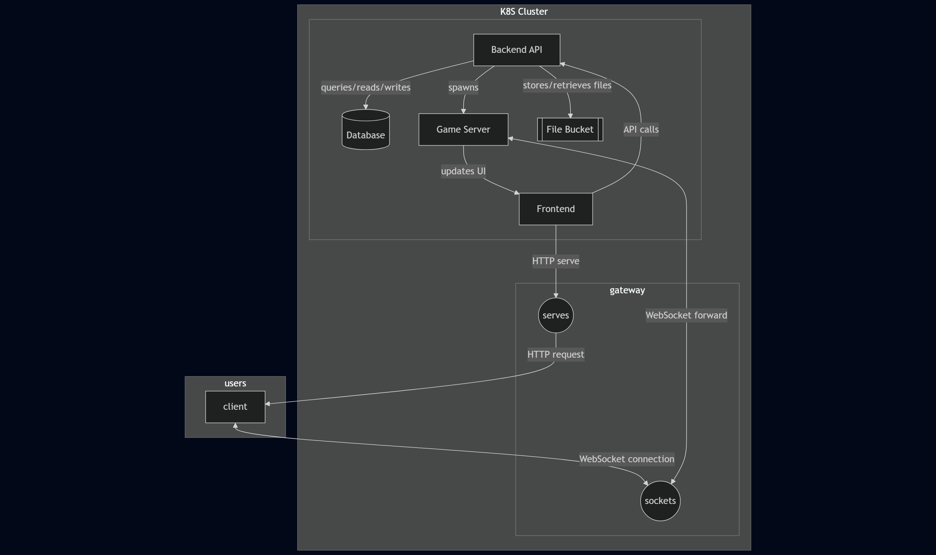

D3
Notes:
Rectangles are machines
Circles are different application layer commincation protocols that are used for a live game
Arrows are labelled indicating the actions being taken.

Slide 8
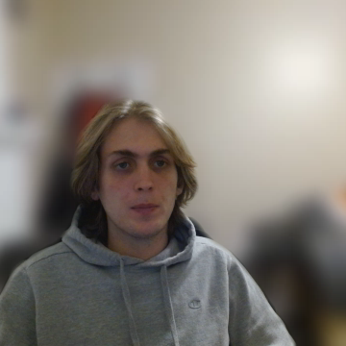
Project constraints
Economic:
Hosting costs
Anything spent on assets
Security
Account file uploads
Legal

Slide 9
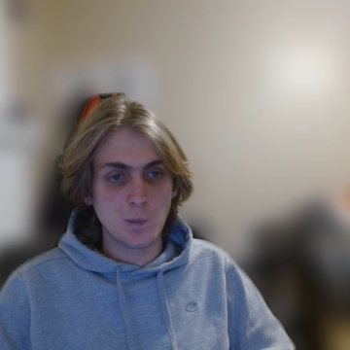
Current State
Implemented database tables for users
Midway through implemented file storage
Most infrastructure is setup for local:
DB
S3
LLM – sglang

Slide 10
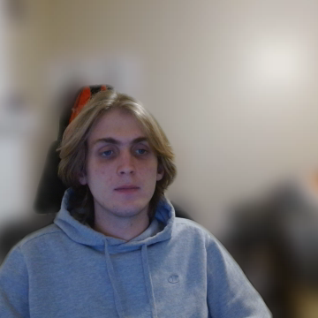
End of term expectations
Have all file-based uploads completed
Full complete guest and user session relation for users joining through a game code.
Have all LLM-powered backend features fill implemented

